Slide 1


Client Confidential
Weekly Quality Report No (54) –01st Oct 2026
Contract No. DD-2023-329 - Opera House
Notes:
Presenter
2025-05-21 16:30:00
--------------------------------------------
Click on slide if image does not load

Slide 2
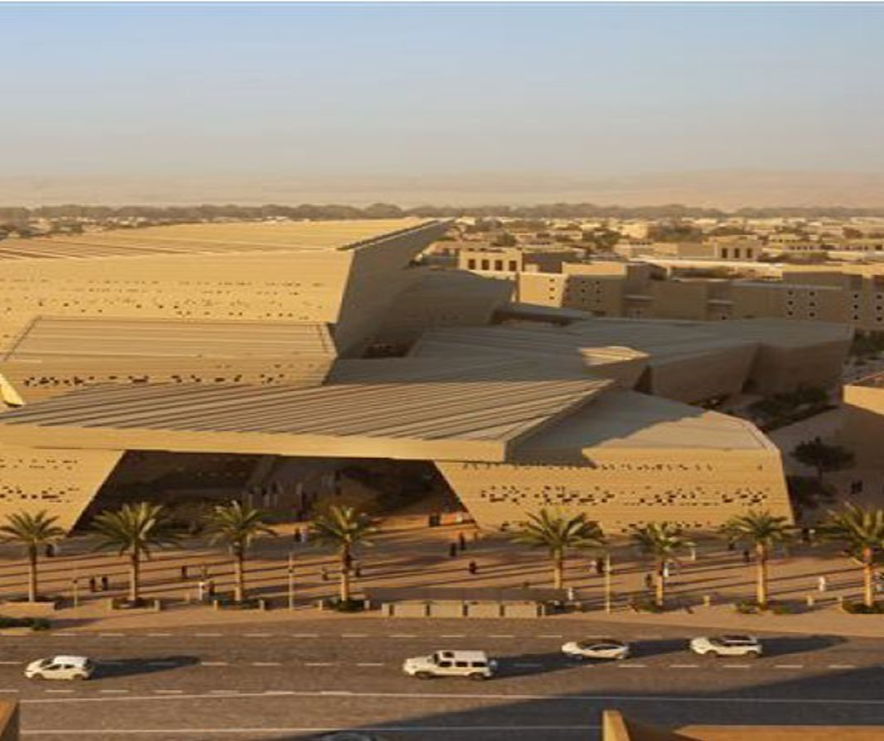
Index
QMS Documentation Status
Construction Submittals
  Method Statement
  Inspection Test Plan
  Material Approval Request
  Shop Drawings
Non-Conformance Report
Training Induction and Compliance
Annual Audit Plan
Quality Resources Deployment
Lessons Learned & Continual Improvement
Quality Monitoring Performance ( Metrics/ KPIs)
Area of Concerns & Mitigation Plans
Any other Business

Slide 3
QMS Documentation Status
DOC. Type | Total | Status-A | Status-B | Status-C | Status-D | QA Rejected | For Info. | Draft/ withdrawn | Under review | Terminated
PLAN | 28 | 16 | 8 | 2 | 0 | 0 | 2 | 0 | 0 | 0
No. | Activity Name | Submission Date |  | Approval Date |  | Revision | Current Status | Latest Re-submitted Date | Forecast resubmission / Status | Remark / Reference
 |  | Baseline Planned | Actual | Baseline | Actual
1 | Project Quality Plan | 17-May-25 | 14-May-25 | 01-Jun-25 | 06-Jul-25 | 3 | A - Work May Proceed |  |  | BV-BSW-105-0000-ECM-PLN-QL-000001
2 | Health Safety Environmental Plan | 17-May-25 | 14-May-25 | 02-Jun-25 | 22-May-25 | 2 | A - Work May Proceed |  |  | BV-BSW-105-0000-ECM-PLN-HS-000001
3 | Logistic Plan | 17-May-25 | 08-May-25 | 02-Jun-25 | 04-Jun-25 | 3 | A - Work May Proceed |  |  | BV-BSW-105-0000-ECM-PLN-LO-000001
4 | Project/Construction Management Plan | 17-May-25 | 14-May-25 | 02-Jun-25 | 20-May-25 | 1 | B - Approved with Comments |  |  | BV-BSW-105-0000-ECM-PLN-MN-000001
5 | BIM Execution Plan | 14-May-25 | 11-June-25 | 02-Jun-25 |  | 4 | B - Approved with Comments |  |  | BV-BSW-105-0000-ECM-PLN-BM-000001
6 | Baseline Programme | 31-May-25 | 29-Jun-25 | 08-Jul-25 | 02-Feb-26 | 2 | B - Approved with Comments |  |  | BV-BSW-105-0000-ECM-SCH-PC-000001
7 | Project Specific Induction Program | 12-Jun-25 | 14-May-25 | 30-Jun-25 | 28-May-25 | 2 | A - Work May Proceed |  |  | BV-BSW-105-0000-ECM-PRO-HS-000001
8 | OHS Proactive Monitoring Program | 12-Jun-25 | 15-May-25 | 30-Jun-25 | 28-May-25 | 2 | A - Work May Proceed |  |  | BV-BSW-105-0000-ECM-PRO-HS-000003
9 | Project Risk Management Plan | 12-Jun-25 | 08-May-25 | 30-Jun-25 | 06-Aug-25 | 3 | A - Work May Proceed |  |  | BV-BSW-105-0000-ECM-PLN-RK-000001
10 | Security & Access Control Plan | 16-Jun-25 | 27-May-25 | 02-Jul-25 | 23-Jun-25 | 2 | A - Work May Proceed
11 | MEPI Plan | 19-Jun-25 | 15-May-25 | 07-Jul-25 | 19-May-25 | 1 | A - Work May Proceed |  |  | BV-BSW-105-0000-ECM-PLN-HS-000005
12 | Construction Environmental Management Plan | 23-Jun-25 | 15-May-25 | 09-Jul-25 | 05-Aug-25 | 2 | A - Work May Proceed |  |  | BV-BSW-105-0000-ECM-PLN-EN-000001
13 | Emergency Management Plan | 26-Jun-25 | 14-May-25 | 14-Jul-25 | 26-May-25 | 3 | A - Work May Proceed |  |  | BV-BSW-105-0000-ECM-PLN-HS-000004
14 | Waste Management Plan | 26-Jun-25 | 14-May-25 | 14-Jul-25 | 04-Jun-25 | 3 | B - Approved with Comments |  |  | BV-BSW-105-0000-ECM-PLN-HS-000002
15 | Fire Prevention Plan | 26-Jun-25 | 17-May-25 | 14-Jul-25 | 22-May-25 | 2 | A - Work May Proceed |  |  | BV-BSW-105-0000-ECM-PLN-HS-000007
16 | Adverse Weather Mitigation Plan | 30-Jun-25 | 14-May-25 | 16-Jul-25 | 15-Jul-25 | 3 | A - Work May Proceed |  |  | BV-BSW-105-0000-ECM-PLN-HS-000006
17 | Traffic Management Plan | 30-Jun-25 |  | 16-Jul-25 |  |  |  |  |  | Submitted as part of Logistic management plan
18 | Flood Mitigation Plan | 03-Jul-25 | 14-May-25 | 21-Jul-25 | 04-Jun-25 | 2 | B - Approved with Comments |  |  | BV-BSW-105-0000-ECM-PLN-HS-000008
19 | Dust and Noise Control Plan |  | 14-May-25 |  | 02-Jun-25 | 1 | B - Approved with Comments |  |  | BV-BSW-105-0000-ECM-PLN-EN-000002
20 | Project Provisional Sum Procurement Strategy Plan | 07-Jul-25 | 25-May-25 | 23-Jul-25 | 01-Jun-25 | 2 | For Info |  |  | BV-BSW-105-0000-ECM-PLN-PR-000001
21 | Secondary PS Procurement Strategy Plan |  | 29-Oct-25 |  | 29-Oct-25 | 0 | For Info |  |  | BV-BSW-105-0000-ECM-PLN-PR-000003
22 | Welfare Facility Plan | 10-Jul-25 | 15-May-25 | 28-Jul-25 | 22-May-25 | 2 | A - Work May Proceed |  |  | BV-BSW-105-0000-ECM-PLN-HS-000003
23 | OHS Resource Deployment Schedule | 10-Jul-25 |  | 28-Jul-25 |  |  |  |  |  | Covered under OHS Plan
24 | Business Continuity Plan | 10-Jul-25 | 02-Jul-25 | 28-Jul-25 | 17-Jul-25 | 1 | A - Work May Proceed |  |  | BV-BSW-105-0000-ECM-PLN-HS-000012
25 | Labor Subsistence Plan |  | 27-Aug-25 |  |  | 2 | B - Approved with Comments |  |  | BV-BSW-105-0000-ECM-PLN-SU-000001
26 | Sustainability Management Action Plan (SMP) |  | 10-Sep-25 |  |  | 1 | C-Revise an Resubmit |  |  | BV-BSW-105-0000-ECM-PLN-SU-000002
27 | Construction Activity Pollution Prevention Plan (ESCP) |  | 06-Oct-25 |  |  | 0 | C-Revise an Resubmit |  |  | BV-BSW-105-0000-ECM-PLN-SU-000003
28 | Project Execution Plan |  |  |  |  | 1 | B - Approved with Comments |  |  | BV-BSW-105-0000-ECM-PLN-MN-000002

Slide 4
QMS Documentation Status
DOC. Type | Total | Status-A | Status-B | Status-C | Under review
QUALITY CONTROL PROCEDURE | 14 | 0 | 12 | 1 | 1
No. | Doc No. | Title | Status
1 | BV-BSW-105-0000-ECM-PRO-QL-000001 | Procedure for Control of Inspection and Testing Activities | Approved
2 | BV-BSW-105-0000-ECM-PRO-QL-000002 | Procedure for Management and Control of Nonconformities (Internal & External NCRs) | Approved
3 | BV-BSW-105-0000-ECM-PRO-QL-000003 | Procedure for Internal and External Audits | Approved
4 | BV-BSW-105-0000-ECM-PRO-QL-000004 | Procedure for Control and Calibration of Measuring and Testing Equipment | Approved
5 | BV-BSW-105-0000-ECM-PRO-QL-000005 | Procedure for Training and Personnel Competency | Approved
6 | BV-BSW-105-0000-ECM-PRO-QL-000006 | Procedure for Lessons Learned | Approved
7 | BV-BSW-105-0000-ECM-PRO-QL-000007 | Procedure for Corrective and Preventive action | Approved
8 | BV-BSW-105-0000-ECM-PRO-QL-000008 | Procedure for Submission of Pre-Qualification of Subcontractor / Supplier and Material Approval Request | Approved
9 | BV-BSW-105-0000-ECM-PRO-QL-000009 | Procedure for Bolt Tightening Procedure For Steel Scope (Zamil) | Approved
10 | BV-BSW-105-0000-ECM-PRO-QL-000010 | Procedure for Quality Control, Fabrication, Handling, Storage & Shipping and Repair of Precast Concrete Elements. | Approved
11 | BV-BSW-105-0000-ECM-PRO-QL-000011 | Touch-UP Procedure For Steel Scope | Approved
12 | BV-BSW-105-0000-ECM-PRO-QL-000012 | Corrective Action/Repair Procedure For Steel Scope - Zamil Steel | Revise and Re-Submit
13 | BV-BSW-105-0000-ECM-PRO-QL-000013 | WELDING PROCEDURE SPECIFICATIONS (WPS & PQR ) | Under Review
14 | BV-BSW-105-0000-ECM-PRO-QL-000014 | WELDING PROCEDURE SPECIFICATIONS (WPS ) | Approved

Slide 5
Construction Submittals – Method Statement
Previous Week (17 Sep to 22 Sep) |  |  |  |  | This Week (24 Sep to 30 Sep) |  |  |  |  | KPI
Total | Code A | Code B | Code C | U/R | Total | Code A | Code B | Code C | U/R | % Approved | % Rejection
86 | 26 | 34 | 20 | 6 | 88 | 26 | 35 | 20 | 7 | 75% | 25%
2 | 0 | 0 | 0 | 2 | 6 | 0 | 0 | 0 | 6 | -% | -%

Slide 6
Construction Submittals – Inspection Test Plan
Period | Previous Week (17 Sep to 22 Sep) |  |  |  |  | This Week (24 Sep to 30 Sep) |  |  |  |  | KPI
 | Total | Code A | Code B | Code C | U/R | Total | Code A | Code B | Code C | U/R | % Approved | % Rejection
Cumulative | 47 | 15 | 21 | 9 | 2 | 47 | 15 | 21 | 11 | 0 | 77% | 23%
Weekly | 2 | 0 | 0 | 0 | 2 | 1 | 0 | 0 | 0 | 1 | -% | -%

Slide 7
Non-Conformance Reports
Period | Previous Week (17 Sep to 22 Sep) |  |  |  |  | This Week (24 Sep to 30 Sep)
 | Total Issued | Respond | Closed | Open | U/R | Total Issued | Respond | Closed | Open | U/R
Cumulative | 49 | 41 | 25 | 19 | 5 | 50 | 43 | 28 | 19 | 3
Weekly | 0 | 0 | 0 | 0 | 0 | 1 | 0 | 0 | 1 | 0

Slide 8
Site Observation Reports
Period | Previous Week (17 Sep to 22 Sep) |  |  |  | This Week (24 Sep to 30 Sep)
 | Issued | Closed | Open | U/R | Issued | Closed | Open | U/R
Cumulative | 72 | 50 | 20 | 2 | 74 | 50 | 24 | 0
Weekly | 1 | 0 | 1 | 0 | 2 | 0 | 2 | 0

Slide 9
Construction Submittals – NCR (Internal)
Period | Last Week (17 Sep to 22 Sep) |  |  |  |  | This Week (24 Sep to 30 Sep)
 | Total Issued | Respond | Closed | Open | U/R | Total Issued | Respond | Closed | Open | U/R
Cumulative | 94 | 80 | 73 | 17 | 4 | 97 | 85 | 77 | 20 | 0
Weekly | 2 | 0 | 0 | 2 | 0 | 3 | 0 | 0 | 3 | 0

Slide 10
Quality Monitoring Performance Metrics – Test Reports
Period | Last Week (17 Sep to 22 Sep) |  |  |  |  | This Week (24 Sep to 30 Sep) |  |  |  |  | KPI
 | Total | Code A | Code B | Code C | U/R | Total | Code A | Code B | Code C | U/R | % Approved | % Rejection
Cumulative | 61 | 35 | 23 | 2 | 1 | 63 | 35 | 24 | 2 | 2 | 97% | 3%
Weekly | 1 | 0 | 0 | 0 | 1 | 2 | 0 | 0 | 0 | 2 | -% | -%

Slide 11
Quality Monitoring Performance Metrics – Prequalification
Period | Last Week (17 Sep to 22 Sep) |  |  |  |  | This Week (24 Sep to 30 Sep) |  |  |  |  | KPI
 | Total | Code A | Code B | Code C | U/R | Total | Code A | Code B | Code C | U/R | % Approved | % Rejection
Cumulative | 196 | 2 | 163 | 25 | 6 | 201 | 2 | 164 | 23 | 12 | 88% | 12%
Weekly | 7 | 0 | 1 | 0 | 6 | 12 | 0 | 1 | 0 | 11 | 100% | 0%

Slide 12
Construction Submittals – Material Approval Request
Period | This Week (17 Sep to 22 Sep) |  |  |  |  | This Week (24 Sep to 30 Sep) |  |  |  |  | KPI
 | Total | Code A | Code B | Code C | U/R | Total | Code A | Code B | Code C | U/R | % Approved | % Rejection
Cumulative | 293 | 2 | 180 | 94 | 17 | 296 | 2 | 184 | 98 | 12 | 65% | 35%
Weekly | 10 | 0 | 1 | 0 | 9 | 9 | 0 | 1 | 1 | 7 | 50% | 50%

Slide 13
Quality Monitoring Performance Metrics – Material Sample Approval
Period | Last Week (17 Sep to 22 Sep) |  |  |  |  | This Week (24 Sep to 30 Sep) |  |  |  |  | KPI
 | Total | Code A | Code B | Code C | U/R | Total | Code A | Code B | Code C | U/R | % Approved | % Rejection
Cumulative | 52 | 9 | 37 | 3 | 3 | 53 | 9 | 38 | 4 | 2 | 92% | 8%
Weekly | 0 | 0 | 0 | 0 | 0 | 2 | 0 | 0 | 0 | 2 | -% | -%

Slide 14
Quality Monitoring Performance Metrics - MIR
Period | This Week (17 Sep to 22 Sep) |  |  |  |  | This Week (24 Sep to 30 Sep) |  |  |  |  | KPI
 | Total | Code A | Code B | Code C | U/R | Total | Code A | Code B | Code C | U/R | % Approved | % Rejection
Cumulative | 455 | 8 | 416 | 18 | 13 | 471 | 8 | 433 | 19 | 11 | 96% | 4%
Weekly | 23 | 0 | 10 | 2 | 11 | 17 | 0 | 8 | 2 | 7 | 80% | 20%

Slide 15
Quality Monitoring Performance Metrics - RFI
Period | Last Week (17 Sep to 22 Sep) |  |  | This Week (24 Sep to 30 Sep) |  |  | KPI
 | TOTAL | RELPY RECD | REPLY NOT RECD | TOTAL | RELPY RECD | REPLY NOT RECD | % Responded | % No Response
Cumulative | 1403 | 1386 | 17 | 1429 | 1403 | 26 | 98% | 2%
Weekly | 15 | 1 | 14 | 26 | 5 | 21 | 80% | 20%

Slide 16
Construction Submittals – Shop Drawings
Period | This Week (17 Sep to 22 Sep) |  |  |  |  | This Week (24 Sep to 30 Sep) |  |  |  |  | KPI
 | Total | Code A | Code B | Code C | U/R | Total | Code A | Code B | Code C | U/R | % Approved | % Rejection
Cumulative | 8822 | 1351 | 5742 | 1294 | 435 | 9151 | 1386 | 6011 | 1320 | 434 | 85% | 15%
Weekly | 59 | 0 | 0 | 0 | 59 | 160 | 0 | 0 | 0 | 160 | -% | -%

Slide 17
Quality Monitoring Performance Metrics - WIR
Period | This Week (17 Sep to 22 Sep) |  |  |  |  | This Week (24 Sep to 30 Sep) |  |  |  |  | KPI
 | Total | Code A | Code B | Code C | U/R | Total | Code A | Code B | Code C | U/R | % Approved | % Rejection
Cumulative | 6850 | 405 | 6081 | 281 | 83 | 7043 | 418 | 6241 | 284 | 100 | 95% | 5%
Weekly | 144 | 0 | 49 | 15 | 80 | 214 | 1 | 105 | 8 | 100 | 93% | 17%
Last Week (17 Sep to 22 Sep)
This Week (24 Sep to 30 Sep)
CODE-B WIRs |  | CODE-C WIRs
Discipline | Number of WIRS | Number of WIRS
Civil | 2475 | 192
Architecture | 67 | 20
Facade | 4 | 2
Electrical | 2189 | 9
Mechanical | 597 | 26
Structure | 26 | 14
Survey | 721 | 17
Acoustics | 2 | 1
Total | 6081 | 281
CODE-B WIRs |  | CODE-C WIRs
Discipline | Number of WIRS | Number of WIRS
Civil | 2515 | 191
Architecture | 69 | 19
Façade | 5 | 3
Electrical | 2260 | 10
Mechanical | 607 | 29
Structure | 32 | 14
Survey | 751 | 17
Acoustics | 2 | 1
Total | 6241 | 284
CODE-A WIRs
Discipline | Number of WIRS
Civil | 398
Architecture | 0
Facade | 0
Electrical | 0
Mechanical | 0
Survey | 7
Total | 405
CODE-A WIRs
Discipline | Number of WIRS
Civil | 411
Architecture | 0
Facade | 0
Electrical | 0
Mechanical | 0
Survey | 7
Total | 418

Slide 18
Training Induction and Compliance

Slide 19
Training Induction and Compliance

Slide 20


Annual Audit Plan (Supplier & Sub-Contractor)
 |  | DD-2023-329 - Diriyah II Management Contracting – Opera Block
 |  | AUDIT PLAN - 2025
Date: 01/May/2025
S. No. | Department / Discipline | Auditor | Audit type | Reference Documents | Location | YEAR 2025
 |  |  |  |  |  | JAN. |  |  |  | FEB. |  |  |  | MAR. |  |  |  | APR. |  |  |  | MAY |  |  |  | JUN. |  |  |  | JUL. |  |  |  | AUG. |  |  |  | SEP. |  |  |  | OCT. |  |  |  | NOV. |  |  |  | DEC.
 |  |  |  |  |  | 1 | 2 | 3 | 4 | 1 | 2 | 3 | 4 | 1 | 2 | 3 | 4 | 1 | 2 | 3 | 4 | 1 | 2 | 3 | 4 | 1 | 2 | 3 | 4 | 1 | 2 | 3 | 4 | 1 | 2 | 3 | 4 | 1 | 2 | 3 | 4 | 1 | 2 | 3 | 4 | 1 | 2 | 3 | 4 | 1 | 2 | 3 | 4
1 | Saudi Ready Mix Batching Plant | QA/QC Manager/ Engineer | Internal Assessment to Supplier | BV-BSW-105-0000-ECM-AUR-QL-000001 | SRM Diriyah |  |  |  |  |  |  |  |  |  |  |  |  |  |  |  |  |  |  |  |  |  |  |  |  |  | x
 |  |  |  |  |  |  |  |  |  |  |  |  |  |  |  |  |  |  |  |  |  |  |  |  |  |  |  |  |  |  |  | l
2 | ACES 3rd Party Lab | QA/QC Manager/ Engineer | Internal Assessment to 3rd party | BV-BSW-105-0000-ECM-AUR-QL-000002 | ACES Riyadh |  |  |  |  |  |  |  |  |  |  |  |  |  |  |  |  |  |  |  |  |  |  |  |  |  |  |  |  |  |  | x
 |  |  |  |  |  |  |  |  |  |  |  |  |  |  |  |  |  |  |  |  |  |  |  |  |  |  |  |  |  |  |  |  |  |  |  |  |  | l
3 | BEC Arabia Batching Plant | QA/QC Manager/ Engineer | Internal Assessment to Supplier | BV-BSW-105-0000-ECM-AUR-QL-000003 | BEC Diriyah |  |  |  |  |  |  |  |  |  |  |  |  |  |  |  |  |  |  |  |  |  |  |  |  |  |  |  |  |  |  |  |  |  |  | x
 |  |  |  |  |  |  |  |  |  |  |  |  |  |  |  |  |  |  |  |  |  |  |  |  |  |  |  |  |  |  |  |  |  |  |  |  |  |  |  | l
4 | Cementix Batching Plant | QA/QC Manager/ Engineer | Internal Assessment to Supplier | BV-BSW-105-0000-ECM-AUR-QL-000004 | Cementix Diriyah |  |  |  |  |  |  |  |  |  |  |  |  |  |  |  |  |  |  |  |  |  |  |  |  |  |  |  |  |  |  |  |  |  |  |  |  |  |  | x
 |  |  |  |  |  |  |  |  |  |  |  |  |  |  |  |  |  |  |  |  |  |  |  |  |  |  |  |  |  |  |  |  |  |  |  |  |  |  | l
5 | Quality Department | QA/QC Manager/ Engineer | Internal HQ Audit to ECM JV | QAM/IA/P189/25/001 | Wadi Al Safar |  |  |  |  |  |  |  |  |  |  |  |  |  |  |  |  |  |  |  |  |  |  |  |  |  |  |  |  |  |  |  |  |  |  |  |  |  |  |  |  |  | x
 |  |  |  |  |  |  |  |  |  |  |  |  |  |  |  |  |  |  |  |  |  |  |  |  |  |  |  |  |  |  |  |  |  |  |  |  |  | l
6 | Unibeton Batching Plant | QA/QC Manager/ Engineer | Internal Assessment to Supplier | BV-BSW-105-0000-ECM-AUR-QL-000005 | Unibeton Diriyah |  |  |  |  |  |  |  |  |  |  |  |  |  |  |  |  |  |  |  |  |  |  |  |  |  |  |  |  |  |  |  |  |  |  |  |  |  |  |  |  |  |  |  |  |  | x
 |  |  |  |  |  |  |  |  |  |  |  |  |  |  |  |  |  |  |  |  |  |  |  |  |  |  |  |  |  |  |  |  |  |  |  |  |  |  |  |  |  | l
7
8
9
10
11
12
Legend
x | Planned Audit
l | Completed Audit
o | Unplanned Audit

Slide 21


Annual Audit Plan (Supplier & Sub-Contractor)
 |  | DD-2023-329 - Diriyah II Management Contracting – Opera Block
 |  | AUDIT PLAN - 2026
Date: 01/May/2026
S. No. | Department / Discipline | Auditor | Audit type | Reference Documents | Location | YEAR 2026
 |  |  |  |  |  | JAN. |  |  |  | FEB. |  |  |  | MAR. |  |  |  | APR. |  |  |  | MAY |  |  |  | JUN. |  |  |  | JUL. |  |  |  | AUG. |  |  |  | SEP. |  |  |  | OCT. |  |  |  | NOV. |  |  |  | DEC.
 |  |  |  |  |  | 1 | 2 | 3 | 4 | 1 | 2 | 3 | 4 | 1 | 2 | 3 | 4 | 1 | 2 | 3 | 4 | 1 | 2 | 3 | 4 | 1 | 2 | 3 | 4 | 1 | 2 | 3 | 4 | 1 | 2 | 3 | 4 | 1 | 2 | 3 | 4 | 1 | 2 | 3 | 4 | 1 | 2 | 3 | 4 | 1 | 2 | 3 | 4
1 | Al Marshad Precast Factory | QA/QC Manager/ Engineer | Assessment of Supplier | BV-BSW-105-0000-ECM-AUR-QL-000006 | Sadus, KSA | l |  | x
2 | M/s Qanbar Dywidag Precast Concrete Co. Ltd. | QA/QC Manager/ Engineer | Assessment of Supplier | BV-BSW-105-0000-ECM-AUR-QL-000007 | Jubail (KSA) |  |  |  |  |  |  |  | x
 |  |  |  |  |  |  |  | l
3 | UBCC Ready Mix Batching Plant | QA/QC Manager/ Engineer | Assessment of Supplier | BV-BSW-105-0000-ECM-AUR-QL-000008 | Wadi Safar (Diriyah) |  |  |  |  |  |  |  |  |  |  | x
 |  |  |  |  |  |  |  | l
4 | M/s Techniproof | QA/QC Manager/ Engineer | Subcontractor Audit |  |  |  |  |  |  |  |  |  |  |  |  |  |  |  |  |  | x
5 | M/s Zamil | QA/QC Manager/ Engineer | Assessment of Supplier | BV-BSW-105-0000-ECM-AUR-QL-000009 | Dammam KSA |  |  |  |  |  |  | x
 |  |  |  |  |  |  |  |  |  |  |  | l
6 | SubContractor - 3 | QA/QC Manager/ Engineer | Internal Assessment to Supplier |  |  |  |  |  |  |  |  |  |  |  |  |  |  |  |  |  |  |  |  |  |  |  |  |  | x
7 | SubContractor - 4 | QA/QC Manager/ Engineer | Internal Assessment to Supplier |  |  |  |  |  |  |  |  |  |  |  |  |  |  |  |  |  |  |  |  |  |  |  |  |  |  |  |  | x
8 | SubContractor - 5 | QA/QC Manager/ Engineer | Internal Assessment to Supplier |  |  |  |  |  |  |  |  |  |  |  |  |  |  |  |  |  |  |  |  |  |  |  |  |  |  |  |  |  |  |  |  |  | x
9 | SubContractor - 6 | QA/QC Manager/ Engineer | Internal Assessment to Supplier |  |  |  |  |  |  |  |  |  |  |  |  |  |  |  |  |  |  |  |  |  |  |  |  |  |  |  |  |  |  |  |  |  |  |  |  | x
10 | SubContractor - 7 | QA/QC Manager/ Engineer | Internal Assessment to Supplier |  |  |  |  |  |  |  |  |  |  |  |  |  |  |  |  |  |  |  |  |  |  |  |  |  |  |  |  |  |  |  |  |  |  |  |  |  |  |  |  |  | x
11 | SubContractor - 8 | QA/QC Manager/ Engineer | Internal Assessment to Supplier |  |  |  |  |  |  |  |  |  |  |  |  |  |  |  |  |  |  |  |  |  |  |  |  |  |  |  |  |  |  |  |  |  |  |  |  |  |  |  |  |  |  |  |  | x
12 | SubContractor - 9 | QA/QC Manager/ Engineer | Internal Assessment to Supplier |  |  |  |  |  |  |  |  |  |  |  |  |  |  |  |  |  |  |  |  |  |  |  |  |  |  |  |  |  |  |  |  |  |  |  |  |  |  |  |  |  |  |  |  |  |  |  |  |  | x
Legend
x | Planned Audit
l | Completed Audit
o | Unplanned Audit

Slide 22
Internal Audit Plan (By Yearly)
 |  | DD-2023-329 - Diriyah II Management Contracting – Opera Block
 |  | INTERNAL AUDIT PLAN - 2026
Date: 01/May/2026
S. No. | Department / Discipline | Auditor | Audit type | Reference Documents | Location | YEAR 2026
 |  |  |  |  |  | JAN. |  |  |  | FEB. |  |  |  | MAR. |  |  |  | APR. |  |  |  | MAY |  |  |  | JUN. |  |  |  | JUL. |  |  |  | AUG. |  |  |  | SEP. |  |  |  | OCT. |  |  |  | NOV. |  |  |  | DEC.
 |  |  |  |  |  | 1 | 2 | 3 | 4 | 1 | 2 | 3 | 4 | 1 | 2 | 3 | 4 | 1 | 2 | 3 | 4 | 1 | 2 | 3 | 4 | 1 | 2 | 3 | 4 | 1 | 2 | 3 | 4 | 1 | 2 | 3 | 4 | 1 | 2 | 3 | 4 | 1 | 2 | 3 | 4 | 1 | 2 | 3 | 4 | 1 | 2 | 3 | 4
1 | ECM JV (Design, Procurement, Construction, Quality, Safety, etc) | QA/QC Manager/ Engineer | Internal Audit |  | Wadi Safar (Diriyah) |  |  |  |  |  |  |  |  |  |  |  |  |  |  |  |  |  |  | x
2 | ECM JV (Design, Procurement, Construction, Quality, Safety, etc) | QA/QC Manager/ Engineer | Internal Audit |  | Wadi Safar (Diriyah) |  |  |  |  |  |  |  |  |  |  |  |  |  |  |  |  |  |  |  |  |  |  |  |  |  |  |  |  |  |  |  |  |  |  |  |  |  |  |  |  |  |  |  |  | x
3
4
5
6
7
8
9
10
11
12
Legend
x | Planned Audit
l | Completed Audit
o | Unplanned Audit

Slide 23
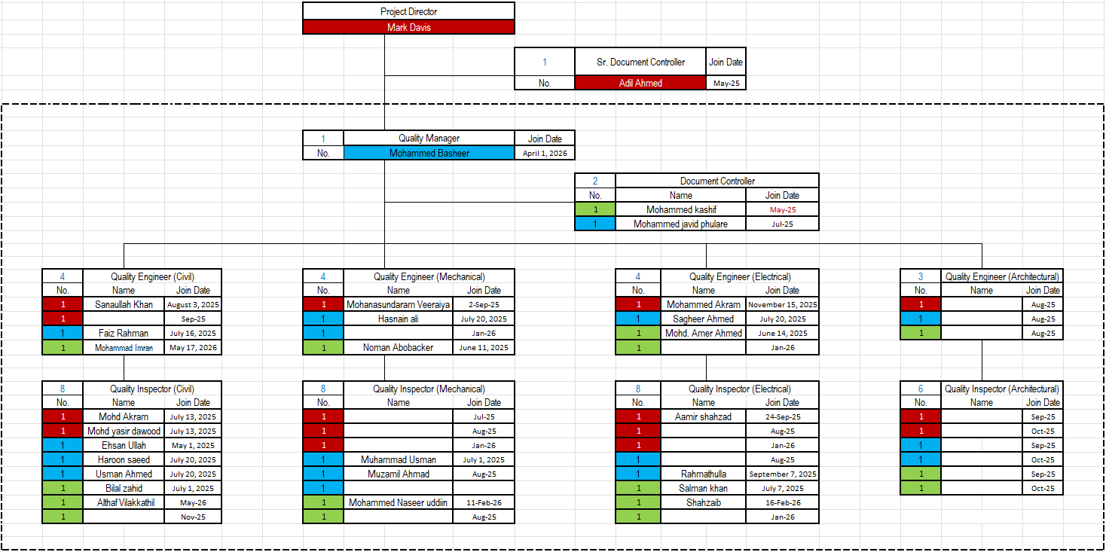
Quality Resources Deployment

Slide 24
Quality Monitoring Performance Metrics - FCR
No Field Change Requests (FCR) raised yet.

Slide 25
Area of Concerns
Sr No | Concern | Mitigation
1 | Leakage of slurry above the wall must be controlled and prevented | Under progress
2 | Debris in construction joints | Ongoing
3 | Major non-compliance identified in the curved wall (Zone 01) concrete casting using Styrofoam formwork. | Dedicated MS for the repair has been submitted (Based on test ECM JV coordinating Sika to proposed material for the repair works)
4 | There is a delay in submitting third-party test reports. All test reports for the months of January and February shall be submitted | All Pending Test Reports are submitted
5 | Expedite the post-pour inspection submission for all vertical elements under SF2 and SF3. | Ongoing
6 | CSC noted that the NCR remains open and overdue, and there is a delay in submitting the third-party report. The required testing was completed three weeks ago; however, the report and recommendations are still pending CSC review and approval. | Under Progress (Third Party Test Report Submitted)

Slide 26
Any Other Business
1. Calibration records shall be submitted Aconex “For Information”.
2. Records of Training/ TBT shall be shared in Aconex “For Information”.

Slide 27




Thank you

